Slide 1
A Small Tutorial on Big Data Integration
Xin Luna Dong (Google Inc.)
Divesh Srivastava (AT&T Labs-Research)
http://www.research.att.com/~divesh/papers/bdi-icde2013.pptx

Slide 2
What is “Big Data Integration?”
Big data integration = Big data + data integration
Data integration: easy access to multiple data sources [DHI12]
Virtual: mediated schema, query redirection, link + fuse answers
Warehouse: materialized data, easy querying, consistency issues
Big data: all about the V’s ☺
Size: large volume of data, collected and analyzed at high velocity
Complexity: huge variety of data, of questionable veracity

Slide 3
What is “Big Data Integration?”
Big data integration = Big data + data integration
Data integration: easy access to multiple data sources [DHI12]
Virtual: mediated schema, query redirection, link + fuse answers
Warehouse: materialized data, easy querying, consistency issues
Big data in the context of data integration: still about the V’s ☺
Size: large volume of sources, changing at high velocity
Complexity: huge variety of sources, of questionable veracity

Slide 4
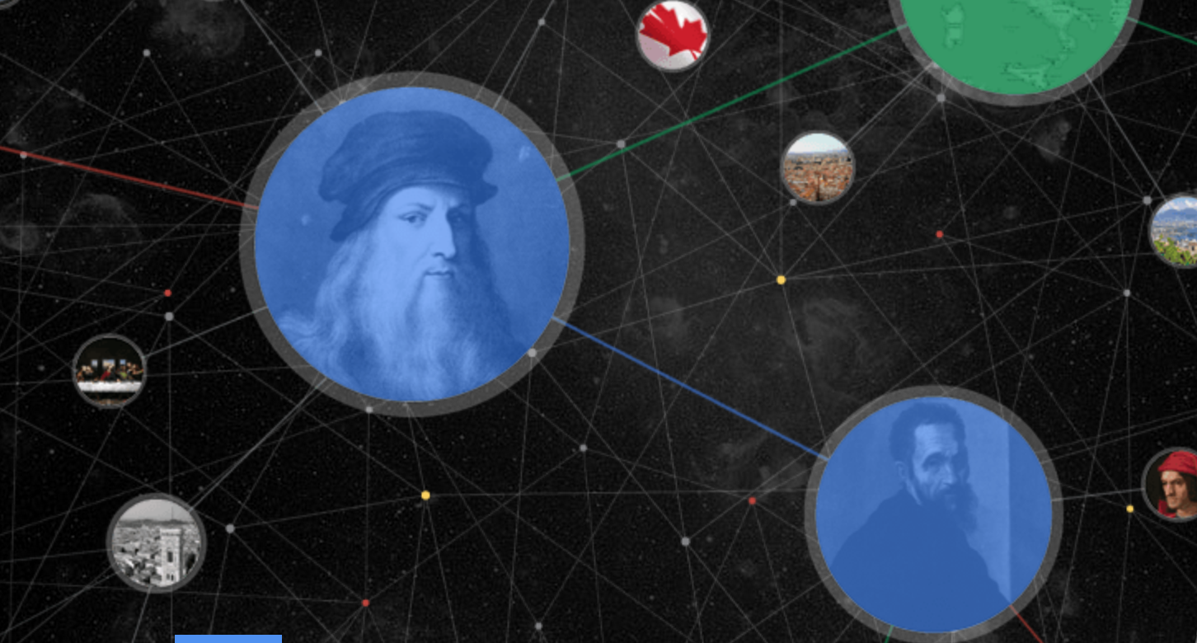



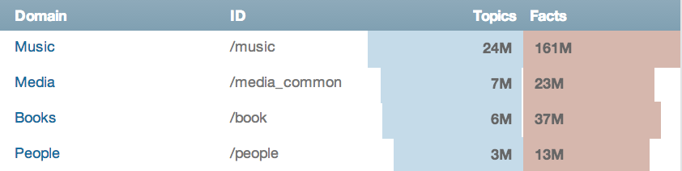
Why Do We Need “Big Data Integration?”
Building web-scale knowledge bases
MSR knowledge base
A Little Knowledge Goes a Long Way.
Google knowledge graph

Slide 5

Why Do We Need “Big Data Integration?”
Reasoning over linked data

Slide 6
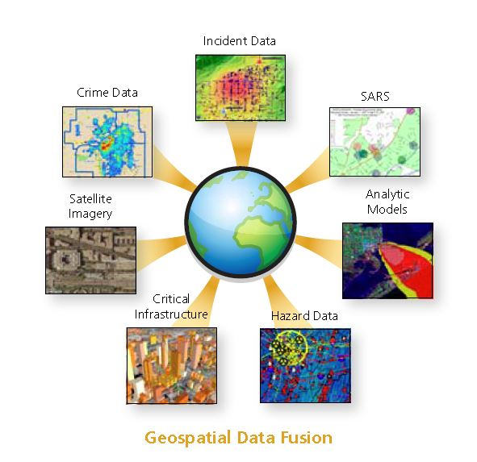
Why Do We Need “Big Data Integration?”
Geo-spatial data fusion
http://axiomamuse.wordpress.com/2011/04/18/

Slide 7
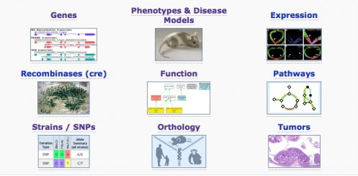
Why Do We Need “Big Data Integration?”
Scientific data analysis
http://scienceline.org/2012/01/from-index-cards-to-information-overload/

Slide 8
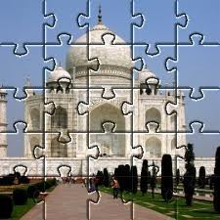


“Small” Data Integration: Why is it Hard?
Data integration = solving lots of jigsaw puzzles
Each jigsaw puzzle (e.g., Taj Mahal) is an integrated entity
Each type of puzzle (e.g., flowers) is an entity domain
Small data integration → small puzzles

Slide 9




“Small” Data Integration: How is it Done?
✓
“Small” data integration: alignment + linkage + fusion
Schema alignment: mapping of structure (e.g., shape)
Schema Alignment
?
Record Linkage
Data Fusion

Slide 10
“Small” Data Integration: How is it Done?
X
“Small” data integration: alignment + linkage + fusion
Schema alignment: mapping of structure (e.g., shape)
Schema Alignment
?
Record Linkage
Data Fusion

Slide 11




“Small” Data Integration: How is it Done?
“Small” data integration: alignment + linkage + fusion
Record linkage: matching based on identifying content (e.g., color)
Schema Alignment
Record Linkage
Data Fusion

Slide 12
“Small” Data Integration: How is it Done?
X
“Small” data integration: alignment + linkage + fusion
Record linkage: matching based on identifying content (e.g., color)
Schema Alignment
Record Linkage
Data Fusion

Slide 13
“Small” Data Integration: How is it Done?
✓
“Small” data integration: alignment + linkage + fusion
Record linkage: matching based on identifying content (e.g., color)
Schema Alignment
Record Linkage
Data Fusion

Slide 14
“Small” Data Integration: How is it Done?
“Small” data integration: alignment + linkage + fusion
Data fusion: reconciliation of non-identifying content (e.g., dots)
Schema Alignment
Record Linkage
Data Fusion

Slide 15
“Small” Data Integration: How is it Done?
X
“Small” data integration: alignment + linkage + fusion
Data fusion: reconciliation of non-identifying content (e.g., dots)
Schema Alignment
Record Linkage
Data Fusion

Slide 16
“Small” Data Integration: How is it Done?
✓
“Small” data integration: alignment + linkage + fusion
Data fusion: reconciliation of non-identifying content (e.g., dots)
Schema Alignment
Record Linkage
Data Fusion

Slide 17

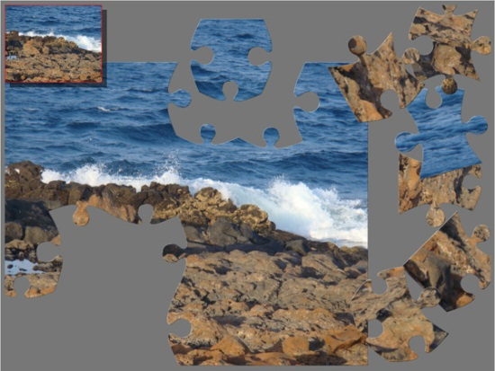
BDI: Why is it Challenging?
Data integration = solving lots of jigsaw puzzles
Big data integration → big, messy puzzles
E.g., missing, duplicate, damaged pieces

Slide 18
BDI: Why is it Challenging?
Number of structured sources: Volume
154 million high quality relational tables on the web [CHW+08]
10s of millions of high quality deep web sources [MKK+08]
10s of millions of useful relational tables from web lists [EMH09]
Challenges:
Difficult to do schema alignment
Expensive to warehouse all the integrated data
Infeasible to support virtual integration

Slide 19
BDI: Why is it Challenging?
Rate of change in structured sources: Velocity
43,000 – 96,000 deep web sources (with HTML forms) [B01]
450,000 databases, 1.25M query interfaces on the web [CHZ05]
10s of millions of high quality deep web sources [MKK+08]
Many sources provide rapidly changing data, e.g., stock prices
Challenges:
Difficult to understand evolution of semantics
Extremely expensive to warehouse data history
Infeasible to capture rapid data changes in a timely fashion

Slide 20
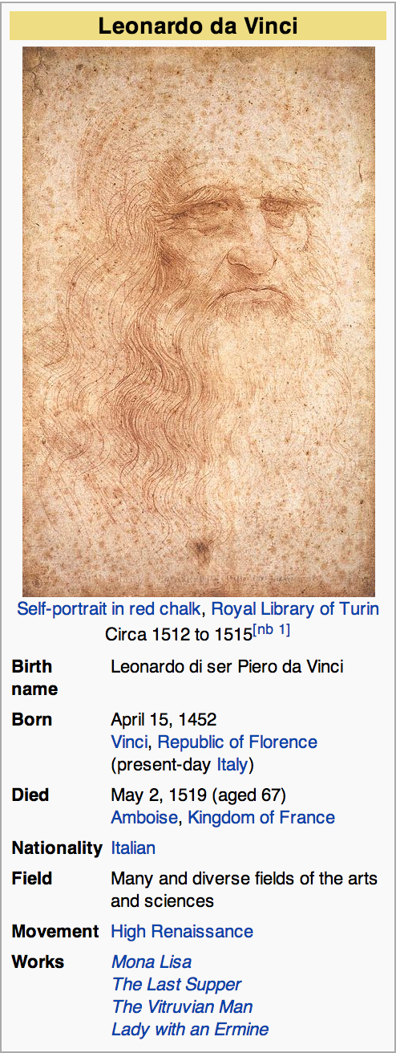
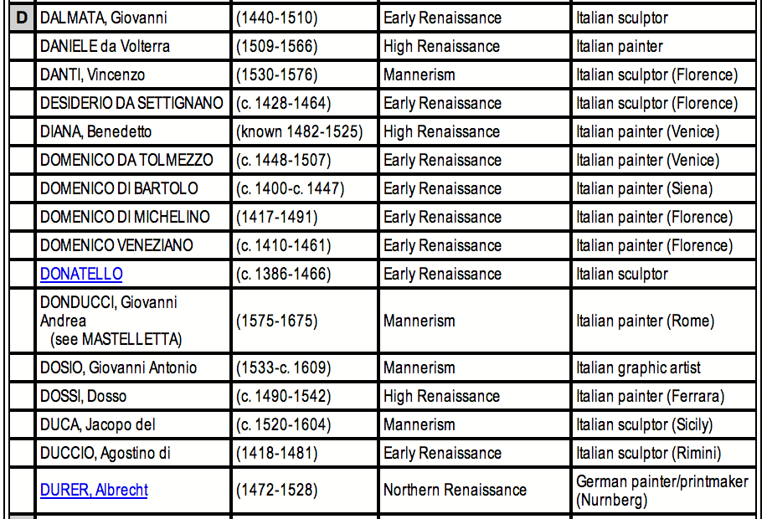
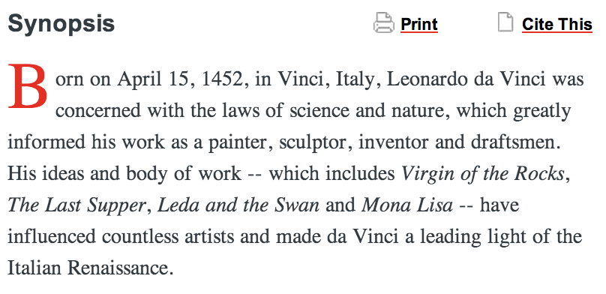
BDI: Why is it Challenging?
Representation differences among sources: Variety
Free-text extractors

Slide 21
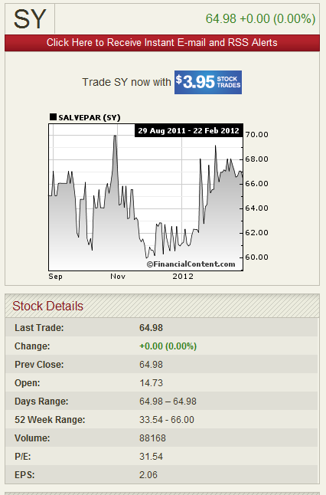
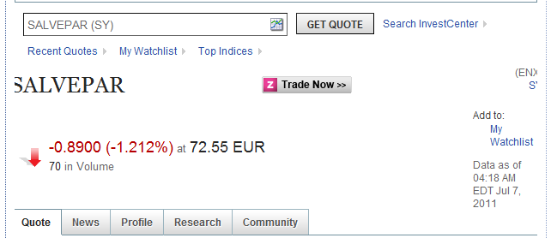
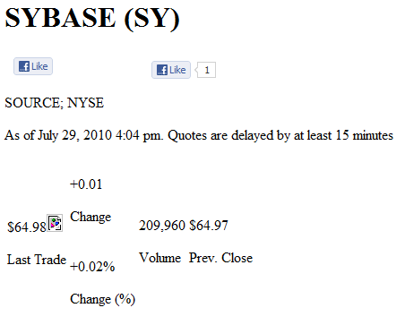
BDI: Why is it Challenging?
Poor data quality of deep web sources [LDL+13]: Veracity

Slide 22
Outline
Motivation
Schema alignment
Overview
Techniques for big data
Record linkage
Data fusion

Slide 23
Schema Alignment
Matching based on structure
?

Slide 24
Schema Alignment
Matching based on structure
?

Slide 25
Schema Alignment: Three Steps [BBR11]
Schema alignment: mediated schema + matching + mapping
Enables linkage, fusion to be semantically meaningful
USP
S1 | (name, games, runs)
S2 | (name, team, score)
S3 | a: (id, name); b: (id, team, runs)
S4 | (name, club, matches)
S5 | (name, team, matches)
Mediated Schema
Attribute Matching
Schema Mapping

Slide 26
Schema Alignment: Three Steps
Schema alignment: mediated schema + matching + mapping
Enables domain specific modeling
USP
S1 | (name, games, runs)
S2 | (name, team, score)
S3 | a: (id, name); b: (id, team, runs)
S4 | (name, club, matches)
S5 | (name, team, matches)
Mediated Schema
Attribute Matching
MS | (n, t, g, s)
Schema Mapping

Slide 27
Schema Alignment: Three Steps
Schema alignment: mediated schema + matching + mapping
Identifies correspondences between schema attributes
USP
S1 | (name, games, runs)
S2 | (name, team, score)
S3 | a: (id, name); b: (id, team, runs)
S4 | (name, club, matches)
S5 | (name, team, matches)
MS | (n, t, g, s)
Mediated Schema
Attribute Matching
MSAM | MS.n: S1.name, S2.name, … MS.t: S2.team, S4.club, … MS.g: S1.games, S4.matches, … MS.s: S1.runs, S2.score, …
Schema Mapping

Slide 28
Schema Alignment: Three Steps
Schema alignment: mediated schema + matching + mapping
Specifies transformation between records in different schemas
S1 | (name, games, runs)
S2 | (name, team, score)
S3 | a: (id, name); b: (id, team, runs)
S4 | (name, club, matches)
S5 | (name, team, matches)
MS | (n, t, g, s)
Mediated Schema
Attribute Matching
MSSM | ∀n, t, g, s (MS(n, t, g, s) → S1(n, g, s) | S2(n, t, s) | i (S3a(i, n) & S3b(i, t, s)) | S4(n, t, g) | S5(n, t, g))
Schema Mapping

Slide 29
Outline
Motivation
Schema alignment
Overview
Techniques for big data
Record linkage
Data fusion

Slide 30
BDI: Schema Alignment
Volume, Variety
Integrating deep web query interfaces [WYD+04, CHZ05]
Dataspace systems [FHM05, HFM06, DHY07]
Keyword search based data integration [TJM+08]
Crawl, index deep web data [MKK+08]
Extract structured data from web tables [CHW+08, PS12, DFG+12] and web lists [GS09, EMH09]
Velocity
Keyword search-based dynamic data integration [TIP10]

Slide 31
Space of Strategies
Now: keyword search over all data sources
Keywords used to query, integrate sources [CHW+08, TJM+08]
Now and soon: automatic lightweight integration
Model uncertainty: probabilistic schema, mappings [DDH09, DHY07]
Cluster sources, enable domain specific integration [CHZ05]
Tomorrow: full-fledged semantic data integration across domains

Slide 32
Space of Strategies
Full semantic integration
Now Soon Tomorrow
Availability of Integration Results
Domain Specific Integration
Probabilistic Integration
Keyword Search
Low Medium High
Level of Semantic Integration

Slide 33
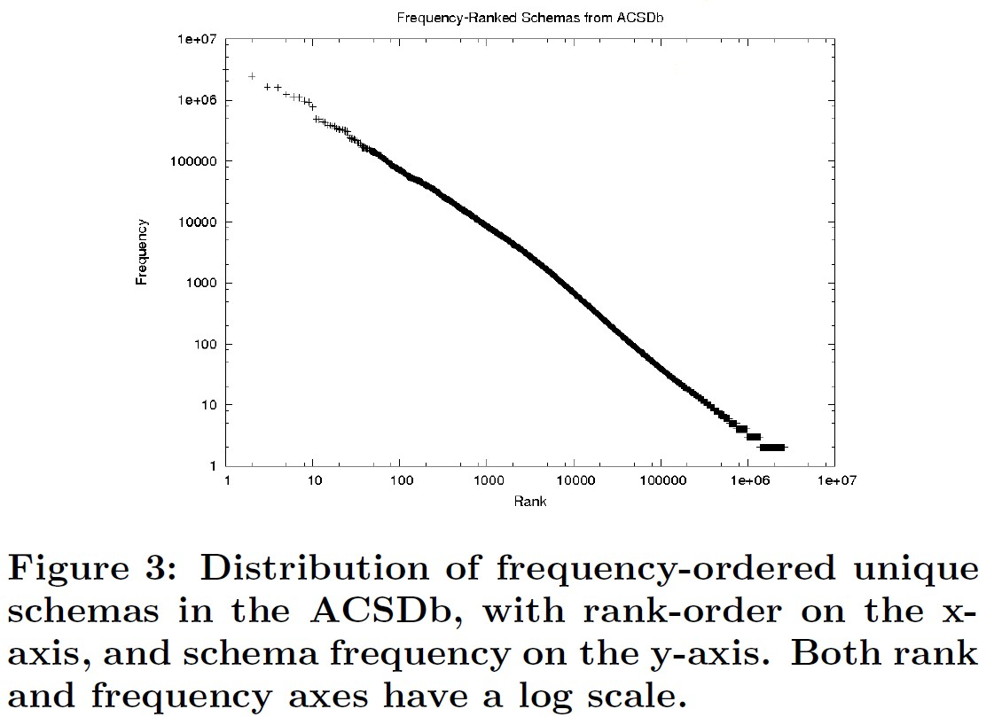
WebTables [CHW+08]
Background: Google crawl of the surface web, reported in 2008
154M good relational tables, 5.4M attribute names, 2.6M schemas
ACSDb
(schema, count)

Slide 34
WebTables: Keyword Ranking [CHW+08]
Goal: Rank tables on web in response to query keywords
Not web pages, not individual records
Challenges:
Web page features apply ambiguously to embedded tables
Web tables on a page may not all be relevant to a query
Web tables have specific features (e.g., schema elements)

Slide 35
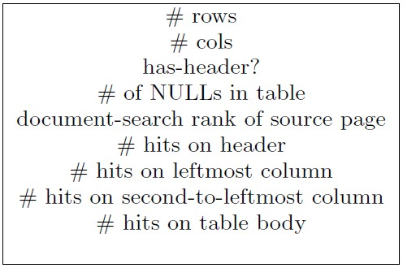
WebTables: Keyword Ranking
FeatureRank: use table specific features
Query independent features
Query dependent features
Linear regression estimator
Heavily weighted features
Result quality: fraction of high scoring relevant tables
k | Naïve | FeatureRank
10 | 0.26 | 0.43
20 | 0.33 | 0.56
30 | 0.34 | 0.66

Slide 36
WebTables: Keyword Ranking
SchemaRank: also include schema coherency
Use point-wise mutual information (pmi) derived from ACSDb
p(S) = fraction of unique schemas containing attributes S
pmi(a,b) = log(p(a,b)/(p(a)*p(b)))
Coherency = average pmi(a,b) over all a, b in attrs(R)
Result quality: fraction of high scoring relevant tables
k | Naïve | FeatureRank | SchemaRank
10 | 0.26 | 0.43 | 0.47
20 | 0.33 | 0.56 | 0.59
30 | 0.34 | 0.66 | 0.68

Slide 37
Dataspace Approach [FHM05, HFM06]
Motivation: SDI approach (as-is) is infeasible for BDI
Volume, variety of sources → unacceptable up-front modeling cost
Velocity of sources → expensive to maintain integration results
Key insight: pay-as-you-go approach may be feasible
Start with simple, universally useful service
Iteratively add complexity when and where needed [JFH08]
Approach has worked for RDBMS, Web, Hadoop …

Slide 38
Probabilistic Mediated Schemas [DDH08]
Mediated schemas: automatically created by inspecting sources
Clustering of source attributes
Volume, variety of sources → uncertainty in accuracy of clustering
S1
S2
S4
name games runs name team score name club matches

Slide 39
Probabilistic Mediated Schemas [DDH08]
Example P-mediated schema
M1({S1.games, S4.matches}, {S1.runs, S2.score})
M2({S1.games, S2.score}, {S1.runs, S4.matches})
M = {(M1, 0.6), (M2, 0.2), (M3, 0.1), (M4, 0.1)}
S1
S2
S4
name games runs name team score name club matches

Slide 40
Probabilistic Mappings [DHY07, DDH09]
Mapping between P-mediated and source schemas
Example mappings
G1({MS.t, S2.team, S4.club}, {MS.g, S4.matches}, {MS.s, S2.score})
G2({MS.t, S2.team, S4.club}, {MS.g, S2.score}, {MS.s, S4.matches})
G = {(G1, 0.6), (G2, 0.2), (G3, 0.1), (G4, 0.1)}
MS
S2
S4
n t g s name team score name club matches

Slide 41
Probabilistic Mappings [DHY07, DDH09]
Mapping between P-mediated and source schemas
Answering queries on P-mediated schema based on P-mappings
By table semantics: one mapping is correct for all tuples
By tuple semantics: different mappings correct for different tuples
MS
S2
S4
n t g s name team score name club matches

Slide 42
Keyword Search Based Integration [TJM+08]
Key idea: information need driven integration
Search graph: source tables with weighted associations
Query keywords: matched to elements in different sources
Derive top-k SQL view, using Steiner tree on search graph
S1
S2
S4
name games runs name team score name club matches
7661 Queensland

Slide 43
Keyword Search Based Integration [TJM+08]
Key idea: information need driven integration
Search graph: source tables with weighted associations
Query keywords: matched to elements in different sources
Derive top-k SQL view, using Steiner tree on search graph
S1
S2
S4
name games runs name team score name club matches
7661 Allan Border Queensland

Slide 44
Outline
Motivation
Schema alignment
Record linkage
Overview
Techniques for big data
Data fusion

Slide 45








Record Linkage
Matching based on identifying content: color, size

Slide 46
Record Linkage
Matching based on identifying content: color, size

Slide 47
Record Linkage: Three Steps [EIV07, GM12]
Record linkage: blocking + pairwise matching + clustering
Scalability, similarity, semantics
Blocking
Pairwise Matching
Clustering

Slide 48
Record Linkage: Three Steps
Blocking: efficiently create small blocks of similar records
Ensures scalability
Blocking
Pairwise Matching
Clustering

Slide 49
Record Linkage: Three Steps
Pairwise matching: compares all record pairs in a block
Computes similarity
Blocking
Pairwise Matching
Clustering

Slide 50
Record Linkage: Three Steps
Clustering: groups sets of records into entities
Ensures semantics
Blocking
Pairwise Matching
Clustering

Slide 51
Outline
Motivation
Schema alignment
Record linkage
Overview
Techniques for big data
Data fusion

Slide 52
BDI: Record Linkage
Volume: dealing with billions of records
Map-reduce based record linkage [VCL10, KTR12]
Adaptive record blocking [DNS+12, MKB12, VN12]
Blocking in heterogeneous data spaces [PIP+12]
Velocity
Incremental record linkage [MSS10]

Slide 53
BDI: Record Linkage
Variety
Matching structured and unstructured data [KGA+11, KTT+12]
Veracity
Linking temporal records [LDM+11]

Slide 54
Record Linkage Using MapReduce [KTR12]
Motivation: despite use of blocking, record linkage is expensive
Can record linkage be effectively parallelized?
Basic: use MapReduce to execute blocking-based RL in parallel
Map tasks can read records, redistribute based on blocking key
All entities of the same block are assigned to same Reduce task
Different blocks matched in parallel by multiple Reduce tasks

Slide 55
Record Linkage Using MapReduce
Challenge: data skew → unbalanced workload

Slide 56
Record Linkage Using MapReduce
Challenge: data skew → unbalanced workload
Speedup: 39/36 = 1.083
3 pairs
36 pairs

Slide 57
Load Balancing
Challenge: data skew → unbalanced workload
Difficult to tune blocking function to get balanced workload
Key ideas for load balancing
Preprocessing MR job to determine blocking key distribution
Redistribution of Match tasks to Reduce tasks to balance workload
Two load balancing strategies:
BlockSplit: split large blocks into sub-blocks
PairRange: global enumeration and redistribution of all pairs

Slide 58
Load Balancing: BlockSplit
Small blocks: processed by a single match task (as in Basic)
3 pairs

Slide 59
Load Balancing: BlockSplit
Large blocks: split into multiple sub-blocks
36 pairs

Slide 60
Load Balancing: BlockSplit
Large blocks: split into multiple sub-blocks

Slide 61
Load Balancing: BlockSplit
Large blocks: split into multiple sub-blocks
Each sub-block processed (like unsplit block) by single match task
10 pairs
6 pairs

Slide 62
Load Balancing: BlockSplit
Large blocks: split into multiple sub-blocks
Pair of sub-blocks is processed by “cartesian product” match task
20 pairs

Slide 63
Load Balancing: BlockSplit
BlockSplit → balanced workload
2 Reduce nodes: 20 versus 19 (6 + 10 + 3)
Speedup: 39/20 = 1.95
3 pairs
10 pairs
6 pairs
20 pairs

Slide 64
Structured + Unstructured Data [KGA+11]
Motivation: matching offers to specifications with high precision
Product specifications are structured: set of (name, value) pairs
Product offers are terse, unstructured text
Many similar but different product offers, specifications
Attribute Name | Attribute Value
category | digital camera
brand | Panasonic
product line | Panasonic Lumix
model | DMC-FX07
resolution | 7 megapixel
color | silver
Panasonic Lumix DMC-FX07 digital camera
[7.2 megapixel, 2.5”, 3.6x , LCD monitor]
Panasonic DMC-FX07EB digital
camera silver
Lumix FX07EB-S, 7.2MP

Slide 65
Structured + Unstructured Data
Key idea: optimal parse of (unstructured) offer wrt specification
Semantic parse of offers: tagging
Use inverted index built on specification values
Tag all n-grams
product line
brand
model
Panasonic Lumix DMC-FX07 digital camera
[7.2 megapixel, 2.5”, 3.6x, LCD monitor]
resolution
zoom
diagonal,
height,
width
display type

Slide 66
Structured + Unstructured Data
Key idea: optimal parse of (unstructured) offer wrt specification
Semantic parse of offers: tagging, plausible parse
Combination of tags such that each attribute has distinct value
product line
brand
model
Panasonic Lumix DMC-FX07 digital camera
[7.2 megapixel, 2.5”, 3.6x, LCD monitor]
resolution
zoom
diagonal,
height,
width
display type

Slide 67
Structured + Unstructured Data
Key idea: optimal parse of (unstructured) offer wrt specification
Semantic parse of offers: tagging, plausible parse
Combination of tags such that each attribute has distinct value
product line
brand
model
Panasonic Lumix DMC-FX07 digital camera
[7.2 megapixel, 2.5”, 3.6x, LCD monitor]
resolution
zoom
diagonal,
height,
width
display type

Slide 68
Structured + Unstructured Data
Key idea: optimal parse of (unstructured) offer wrt specification
Semantic parse of offers: tagging, plausible parse
Combination of tags such that each attribute has distinct value
# depends on ambiguities
product line
brand
model
Panasonic Lumix DMC-FX07 digital camera
[7.2 megapixel, 2.5”, 3.6x, LCD monitor]
resolution
zoom
diagonal,
height,
width
display type

Slide 69
Structured + Unstructured Data
Key idea: optimal parse of (unstructured) offer wrt specification
Semantic parse of offers: tagging, plausible parse, optimal parse
Optimal parse depends on the product specification
Product specification | Optimal Parse
brand Panasonic product line Lumix model DMC-FX05 diagonal 2.5 in
brand Panasonic model DMC-FX07 resolution 7.2 megapixel zoom 3.6x
Panasonic Lumix DMC-FX07 digital camera
[7.2 megapixel, 2.5”, 3.6x, LCD monitor]
Panasonic Lumix DMC-FX07 digital camera
[7.2 megapixel, 2.5”, 3.6x, LCD monitor]

Slide 70
Structured + Unstructured Data
Key idea: optimal parse of (unstructured) offer wrt specification
Semantic parse of offers: tagging, plausible parse, optimal parse
Finding specification with largest match probability is now easy
Similarity feature vector between offer and specification: {-1, 0, 1}*
Use binary logistic regression to learn weights of each feature
Blocking 1: use classifier to categorize offer into product category
Blocking 2: identify candidates with ≥ 1 high weighted feature

Slide 71
Outline
Motivation
Schema alignment
Record linkage
Data fusion
Overview
Techniques for big data

Slide 72

Data Fusion
Reconciliation of conflicting non-identifying content

Slide 73
Data Fusion
Reconciliation of conflicting non-identifying content: dots

Slide 74
Data Fusion
Reconciliation of conflicting non-identifying content: dots

Slide 75
Data Fusion: Three Components [DBS09a]
Data fusion: voting + source quality + copy detection
Resolves inconsistency across diversity of sources
USP
Voting
 | S1 | S2 | S3 | S4 | S5
Jagadish | UM | ATT | UM | UM | UI
Dewitt | MSR | MSR | UW | UW | UW
Bernstein | MSR | MSR | MSR | MSR | MSR
Carey | UCI | ATT | BEA | BEA | BEA
Franklin | UCB | UCB | UMD | UMD | UMD
Source Quality
Copy Detection

Slide 76
Data Fusion: Three Components [DBS09a]
Data fusion: voting + source quality + copy detection
USP
Voting
 | S1 | S2 | S3
Jagadish | UM | ATT | UM
Dewitt | MSR | MSR | UW
Bernstein | MSR | MSR | MSR
Carey | UCI | ATT | BEA
Franklin | UCB | UCB | UMD
Source Quality
Copy Detection

Slide 77
Data Fusion: Three Components [DBS09a]
Data fusion: voting + source quality + copy detection
Supports difference of opinion
USP
Voting
 | S1 | S2 | S3
Jagadish | UM | ATT | UM
Dewitt | MSR | MSR | UW
Bernstein | MSR | MSR | MSR
Carey | UCI | ATT | BEA
Franklin | UCB | UCB | UMD
Source Quality
Copy Detection

Slide 78
Data Fusion: Three Components [DBS09a]
Data fusion: voting + source quality + copy detection
USP
Voting
 | S1 | S2 | S3
Jagadish | UM | ATT | UM
Dewitt | MSR | MSR | UW
Bernstein | MSR | MSR | MSR
Carey | UCI | ATT | BEA
Franklin | UCB | UCB | UMD
Source Quality
Copy Detection

Slide 79
Data Fusion: Three Components [DBS09a]
Data fusion: voting + source quality + copy detection
Gives more weight to knowledgeable sources
USP
Voting
 | S1 | S2 | S3
Jagadish | UM | ATT | UM
Dewitt | MSR | MSR | UW
Bernstein | MSR | MSR | MSR
Carey | UCI | ATT | BEA
Franklin | UCB | UCB | UMD
Source Quality
Copy Detection

Slide 80
Data Fusion: Three Components [DBS09a]
Data fusion: voting + source quality + copy detection
USP
Voting
 | S1 | S2 | S3 | S4 | S5
Jagadish | UM | ATT | UM | UM | UI
Dewitt | MSR | MSR | UW | UW | UW
Bernstein | MSR | MSR | MSR | MSR | MSR
Carey | UCI | ATT | BEA | BEA | BEA
Franklin | UCB | UCB | UMD | UMD | UMD
Source Quality
Copy Detection

Slide 81
Data Fusion: Three Components [DBS09a]
Data fusion: voting + source quality + copy detection
USP
Voting
 | S1 | S2 | S3 | S4 | S5
Jagadish | UM | ATT | UM | UM | UI
Dewitt | MSR | MSR | UW | UW | UW
Bernstein | MSR | MSR | MSR | MSR | MSR
Carey | UCI | ATT | BEA | BEA | BEA
Franklin | UCB | UCB | UMD | UMD | UMD
Source Quality
Copy Detection

Slide 82
Data Fusion: Three Components [DBS09a]
Data fusion: voting + source quality + copy detection
Reduces weight of copier sources
USP
Voting
 | S1 | S2 | S3 | S4 | S5
Jagadish | UM | ATT | UM | UM | UI
Dewitt | MSR | MSR | UW | UW | UW
Bernstein | MSR | MSR | MSR | MSR | MSR
Carey | UCI | ATT | BEA | BEA | BEA
Franklin | UCB | UCB | UMD | UMD | UMD
Source Quality
Copy Detection

Slide 83
Outline
Motivation
Schema alignment
Record linkage
Data fusion
Overview
Techniques for big data

Slide 84
BDI: Data Fusion
Veracity
Using source trustworthiness [YJY08, GAM+10, PR11]
Combining source accuracy and copy detection [DBS09a]
Multiple truth values [ZRG+12]
Erroneous numeric data [ZH12]
Experimental comparison on deep web data [LDL+13]

Slide 85
BDI: Data Fusion
Volume:
Online data fusion [LDO+11]
Velocity
Truth discovery for dynamic data [DBS09b, PRM+12]
Variety
Combining record linkage with data fusion [GDS+10]

Slide 86
Experimental Study on Deep Web [LDL+13]
Study on two domains
Belief of clean data
Poor quality data can have big impact
 | #Sources | Period | #Objects | #Local-attrs | #Global-attrs | Considered items
Stock | 55 | 7/2011 | 1000*20 | 333 | 153 | 16000*20
Flight | 38 | 12/2011 | 1200*31 | 43 | 15 | 7200*31

Slide 87
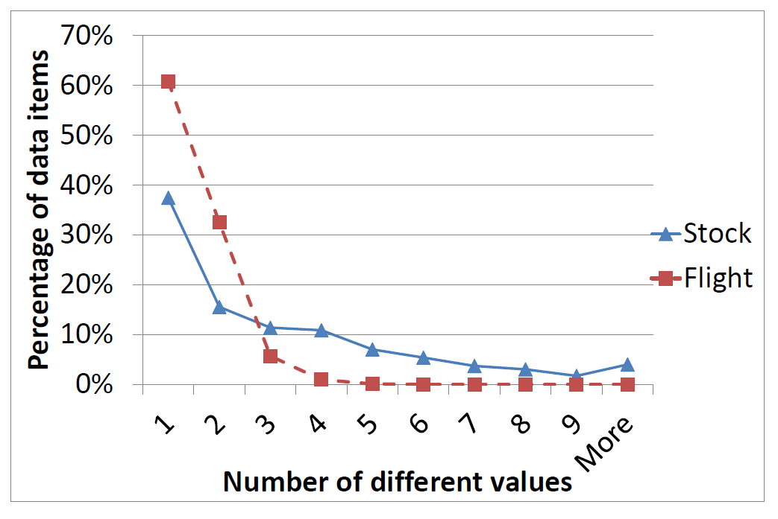
Experimental Study on Deep Web
Is the data consistent?
Tolerance to 1% value difference

Slide 88
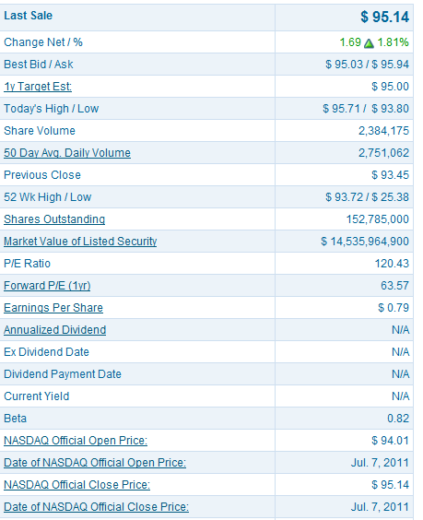
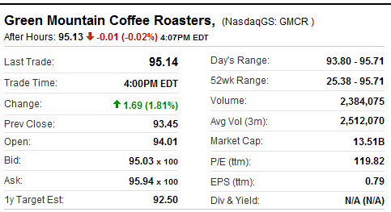
Experimental Study on Deep Web
Why such inconsistency?
Semantic ambiguity
Nasdaq
Yahoo! Finance
Day’s Range: 93.80-95.71
52wk Range: 25.38-95.71
52 Wk: 25.38-93.72

Slide 89

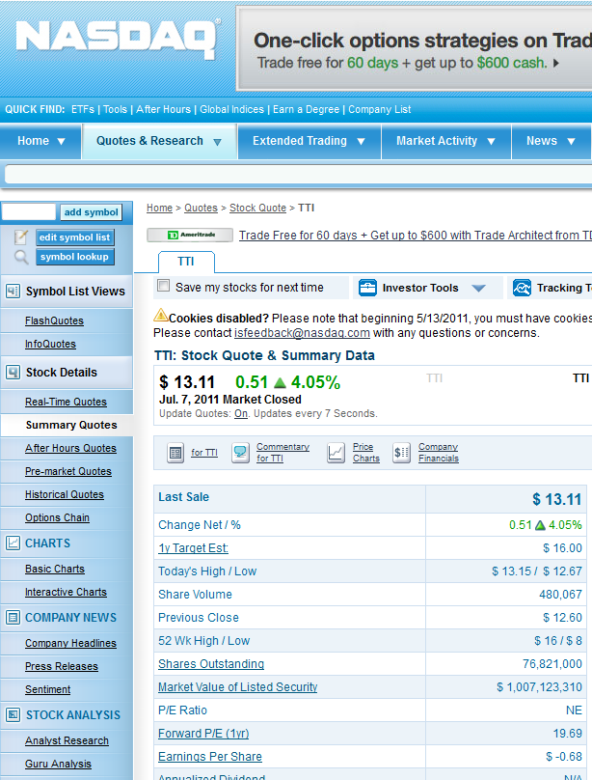
Experimental Study on Deep Web
Why such inconsistency?
Unit errors
76.82B
76,821,000

Slide 90
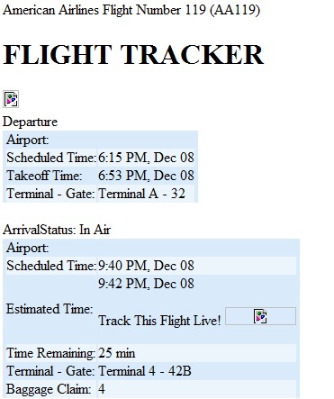
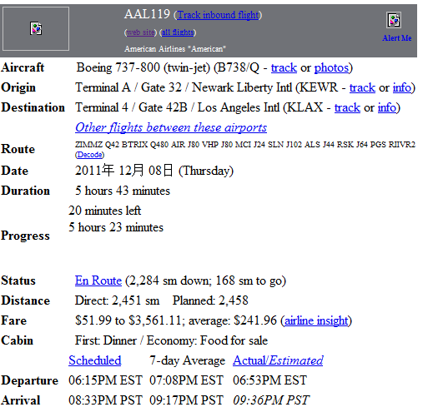
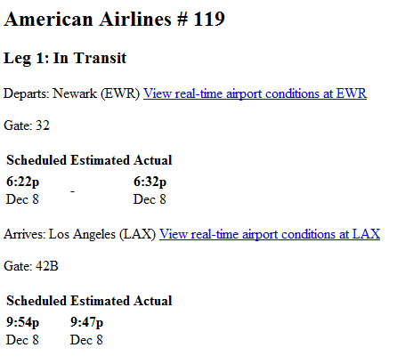
Experimental Study on Deep Web
Why such inconsistency?
Pure errors
FlightView
FlightAware
Orbitz
6:15 PM
6:22 PM
6:15 PM
9:40 PM
9:54 PM
8:33 PM

Slide 91
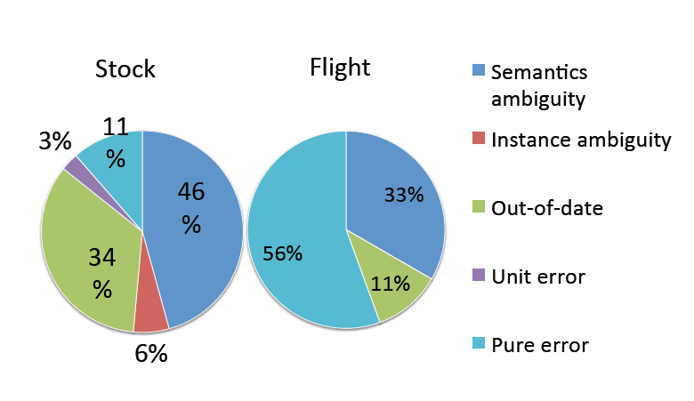
Experimental Study on Deep Web
Why such inconsistency?
Random sample of 20 data items + 5 items with largest # of values

Slide 92

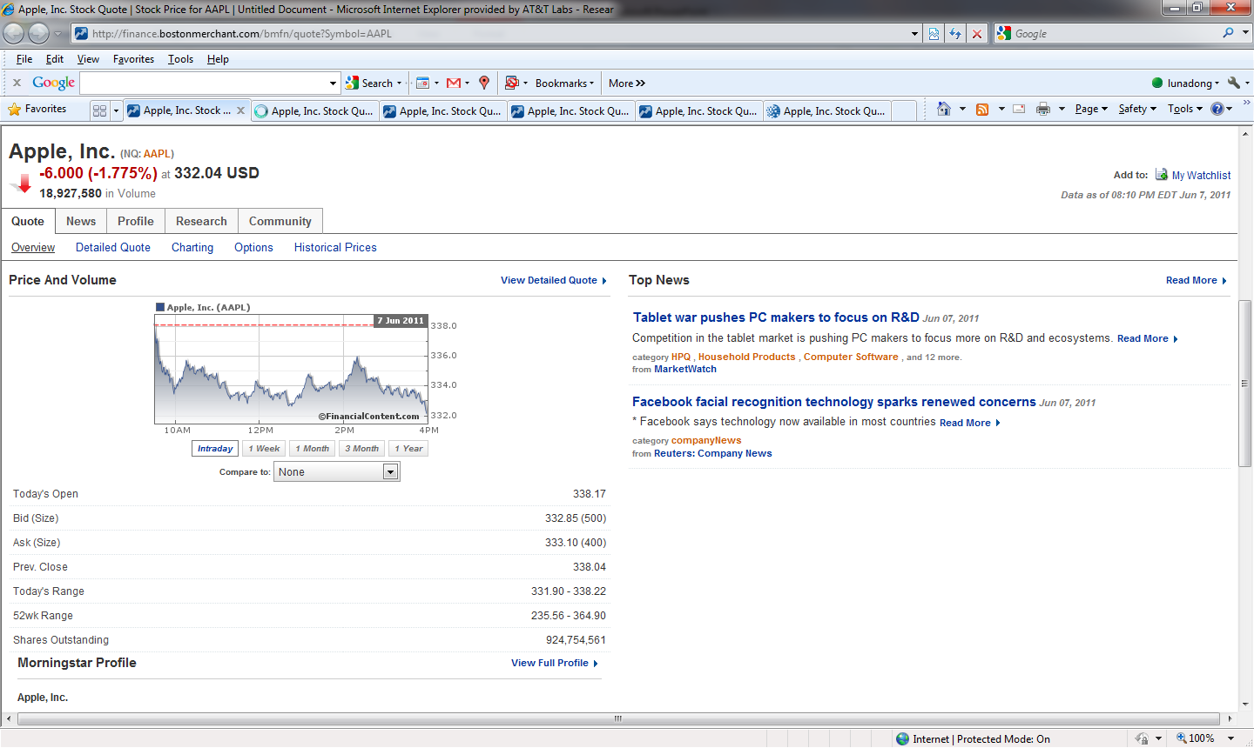
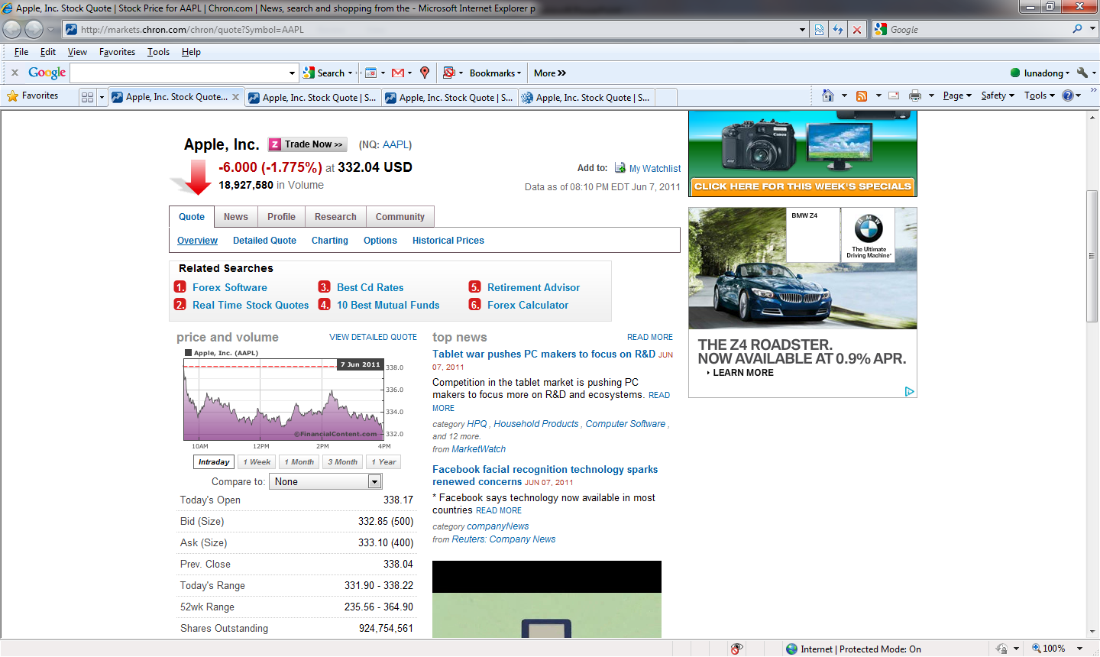
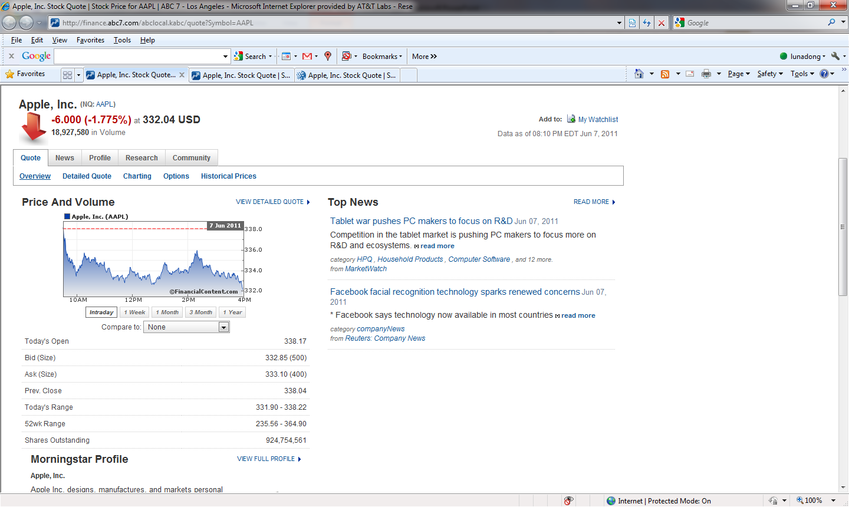
Experimental Study on Deep Web
Copying between sources?

Slide 93
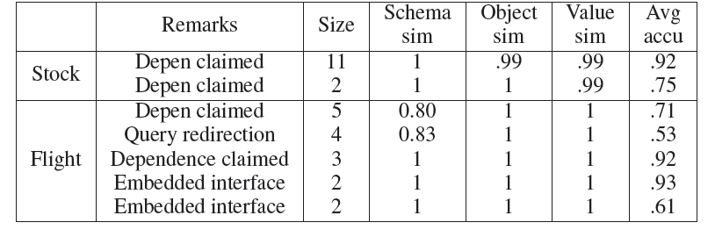
Experimental Study on Deep Web
Copying on erroneous data?

Slide 94
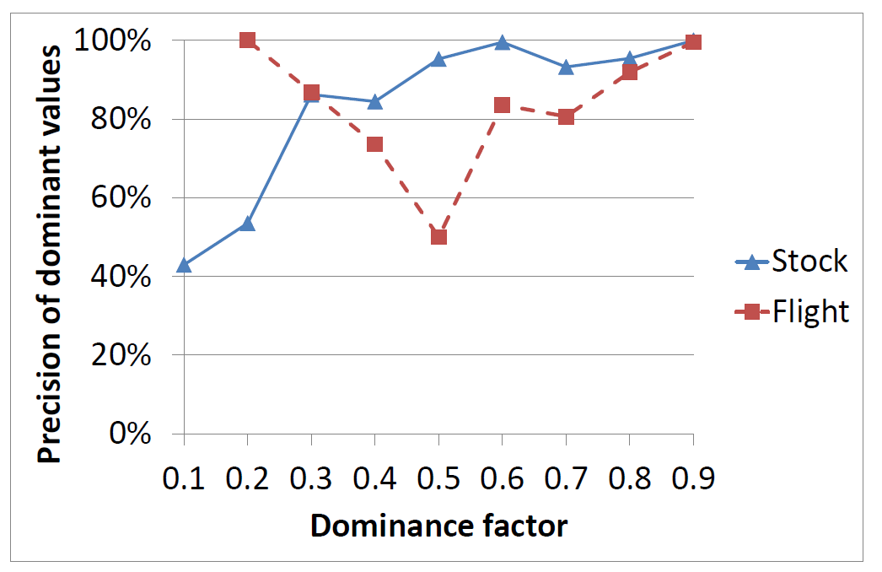
Experimental Study on Deep Web
Basic solution: naïve voting
.908 voting precision for Stock, .864 voting precision for Flight
Only 70% correct values are provided by over half of the sources

Slide 95
Source Accuracy [DBS09a]
Computing source accuracy: A(S) = Avg _{vi(D) ∈ S} Pr(v_{i}(D) true | Ф)
v_{i}(D) ∈ S : S provides value v_{i} on data item D
Ф: observations on all data items by sources S
Pr(v_{i}(D) true | Ф) : probability of v_{i}(D) being true
How to compute Pr(v_{i}(D) true | Ф)?

Slide 96
Source Accuracy
Input: data item D, val(D) = {v₀,v₁,…,v_{n}}, Ф
Output: Pr(v_{i}(D) true | Ф), for i=0,…, n (sum=1)
Based on Bayes Rule, need Pr(Ф | v_{i}(D) true)
Under independence, need Pr(Ф_{D}(S)|v_{i}(D) true)
If S provides v_{i} : Pr(Ф_{D}(S) |v_{i}(D) true) = A(S)
If S does not : Pr(Ф_{D}(S) |v_{i}(D) true) =(1-A(S))/n
Challenge:
Inter-dependence between source accuracy and value probability?

Slide 97
Source Accuracy
Continue until source accuracy converges
Source Accuracy
Value Probability
Source Vote Count
ValueVote Count

Slide 98
Value Similarity
Continue until source accuracy converges
Source Accuracy
Value Probability
Source Vote Count
Consider value similarity
ValueVote Count

Slide 99
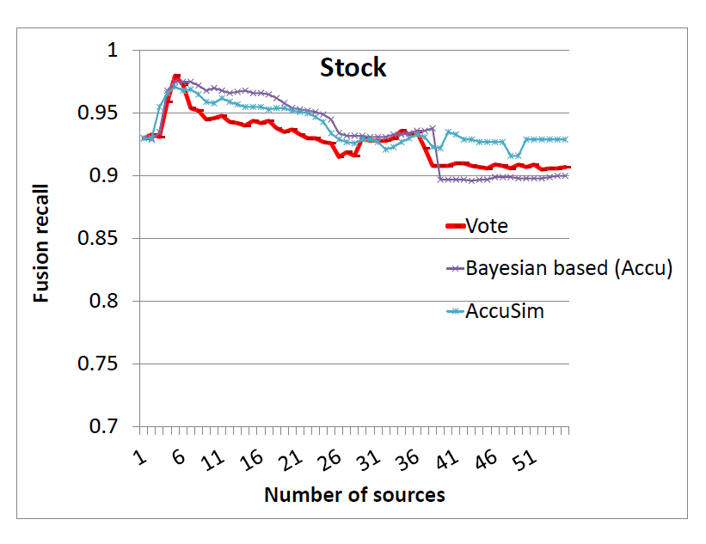
Experimental Study on Deep Web
Result on Stock data
AccuSim’s final precision is .929, higher than other methods

Slide 100
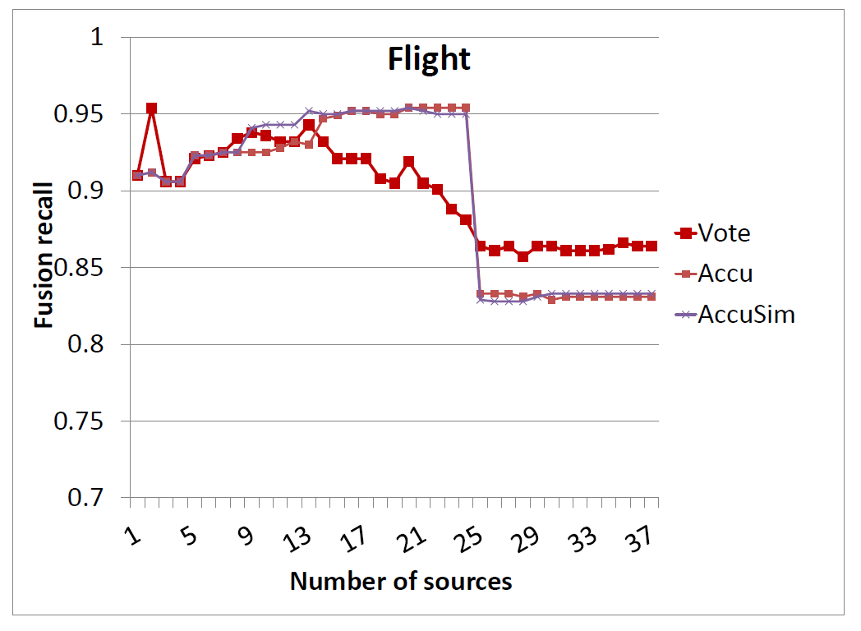
Experimental Study on Deep Web
Result on Flight data
AccuSim’s final precision is .833, lower than Vote (.857); why?

Slide 101
Experimental Study on Deep Web
Copying on erroneous data

Slide 102
Copy Detection
Are Source 1 and Source 2 dependent?
Not necessarily
Source 1 on USA Presidents:
1st : George Washington
2nd : John Adams
3rd : Thomas Jefferson
4th : James Madison
…
41st : George H.W. Bush
42nd : William J. Clinton
43rd : George W. Bush
44th: Barack Obama
Source 2 on USA Presidents:
1st : George Washington
2nd : John Adams
3rd : Thomas Jefferson
4th : James Madison
…
41st : George H.W. Bush
42nd : William J. Clinton
43rd : George W. Bush
44th: Barack Obama
✓
✓
✓
✓
✓
✓
✓
✓

Slide 103
Copy Detection
Are Source 1 and Source 2 dependent?
Very likely
Source 1 on USA Presidents:
1st : George Washington
2nd : Benjamin Franklin
3rd : John F. Kennedy
4th : Abraham Lincoln
…
41st : George W. Bush
42nd : Hillary Clinton
43rd : Dick Cheney
44th: Barack Obama
Source 2 on USA Presidents:
1st : George Washington
2nd : Benjamin Franklin
3rd : John F. Kennedy
4th : Abraham Lincoln
…
41st : George W. Bush
42nd : Hillary Clinton
43rd : Dick Cheney
44th: John McCain
✓
✗
✗
✗
✗
✗
✗

Slide 104
Copy Detection: Bayesian Analysis
Goal: Pr(S1⊥S2| Ф), Pr(S1∼S2| Ф) (sum = 1)
According to Bayes Rule, we need Pr(Ф|S1⊥S2), Pr(Ф|S1∼S2)
Key: compute Pr(Ф_{D}|S1⊥S2), Pr(Ф_{D}|S1∼S2), for each D ∈ S1 ∩ S2
Different Values O_{d}
Same Values
TRUE O_{t}
FALSE O_{f}
S1 ∩ S2

Slide 105
Copy Detection: Bayesian Analysis
Different Values O_{d}
Same Values
TRUE O_{t}
FALSE O_{f}
S1 ∩ S2
Pr | Independence | Copying
O_{t}
O_{f}
O_{d}
<
<<
>

Slide 106
Discount Copied Values
Continue until convergence
Source Accuracy
Value Probability
Source Vote Count
ValueVote Count
Consider dependence
I(S)- Pr of independently providing value v

Slide 107
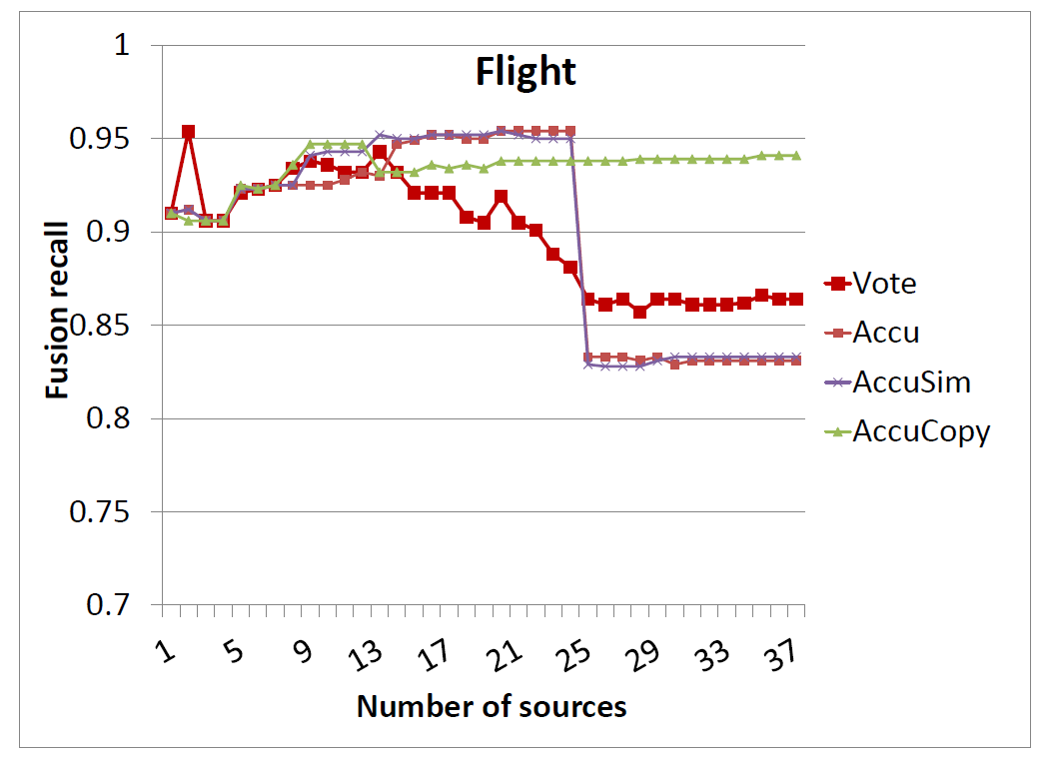
Experimental Study on Deep Web
Result on Flight data
AccuCopy’s final precision is .943, much higher than Vote (.864)

Slide 108
Summary
 | Schema alignment | Record linkage | Data fusion
Volume | Integrating deep Web Web table/lists | Adaptive blocking | Online fusion
Velocity | Keyword-based integration for dynamic data | Incremental linkage | Fusion for dynamic data
Variety | Dataspaces Keyword-based integration | Linking texts to structured data | Combining fusion with linkage
Veracity |  | Value-variety tolerant RL | Truth discovery

Slide 109
Outline
Motivation
Schema alignment
Record linkage
Data fusion
Future work

Slide 110



Future Work
Reconsider the architecture
Data warehousing
Virtual integration

Slide 111
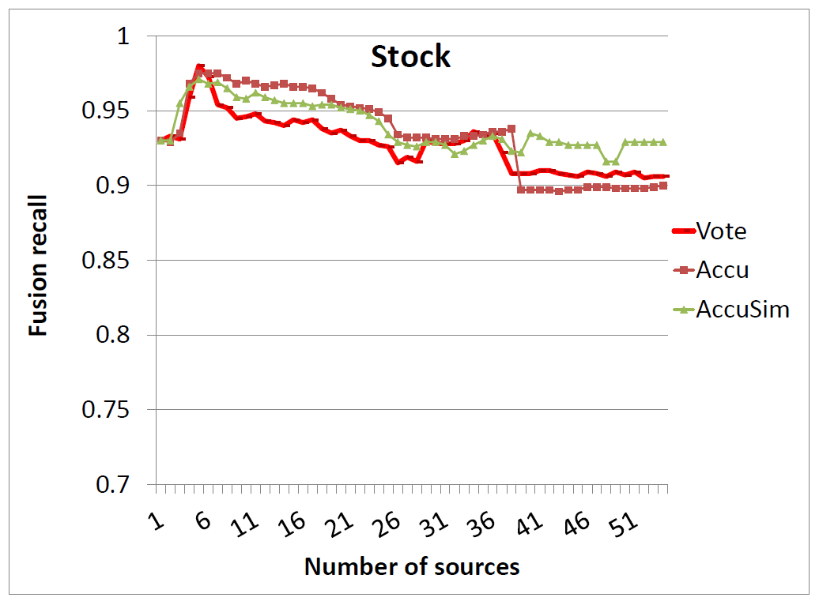
Future Work
The more, the better?

Slide 112
Future Work
Combining different components
Schema Alignment
Record Linkage
Data Fusion

Slide 113
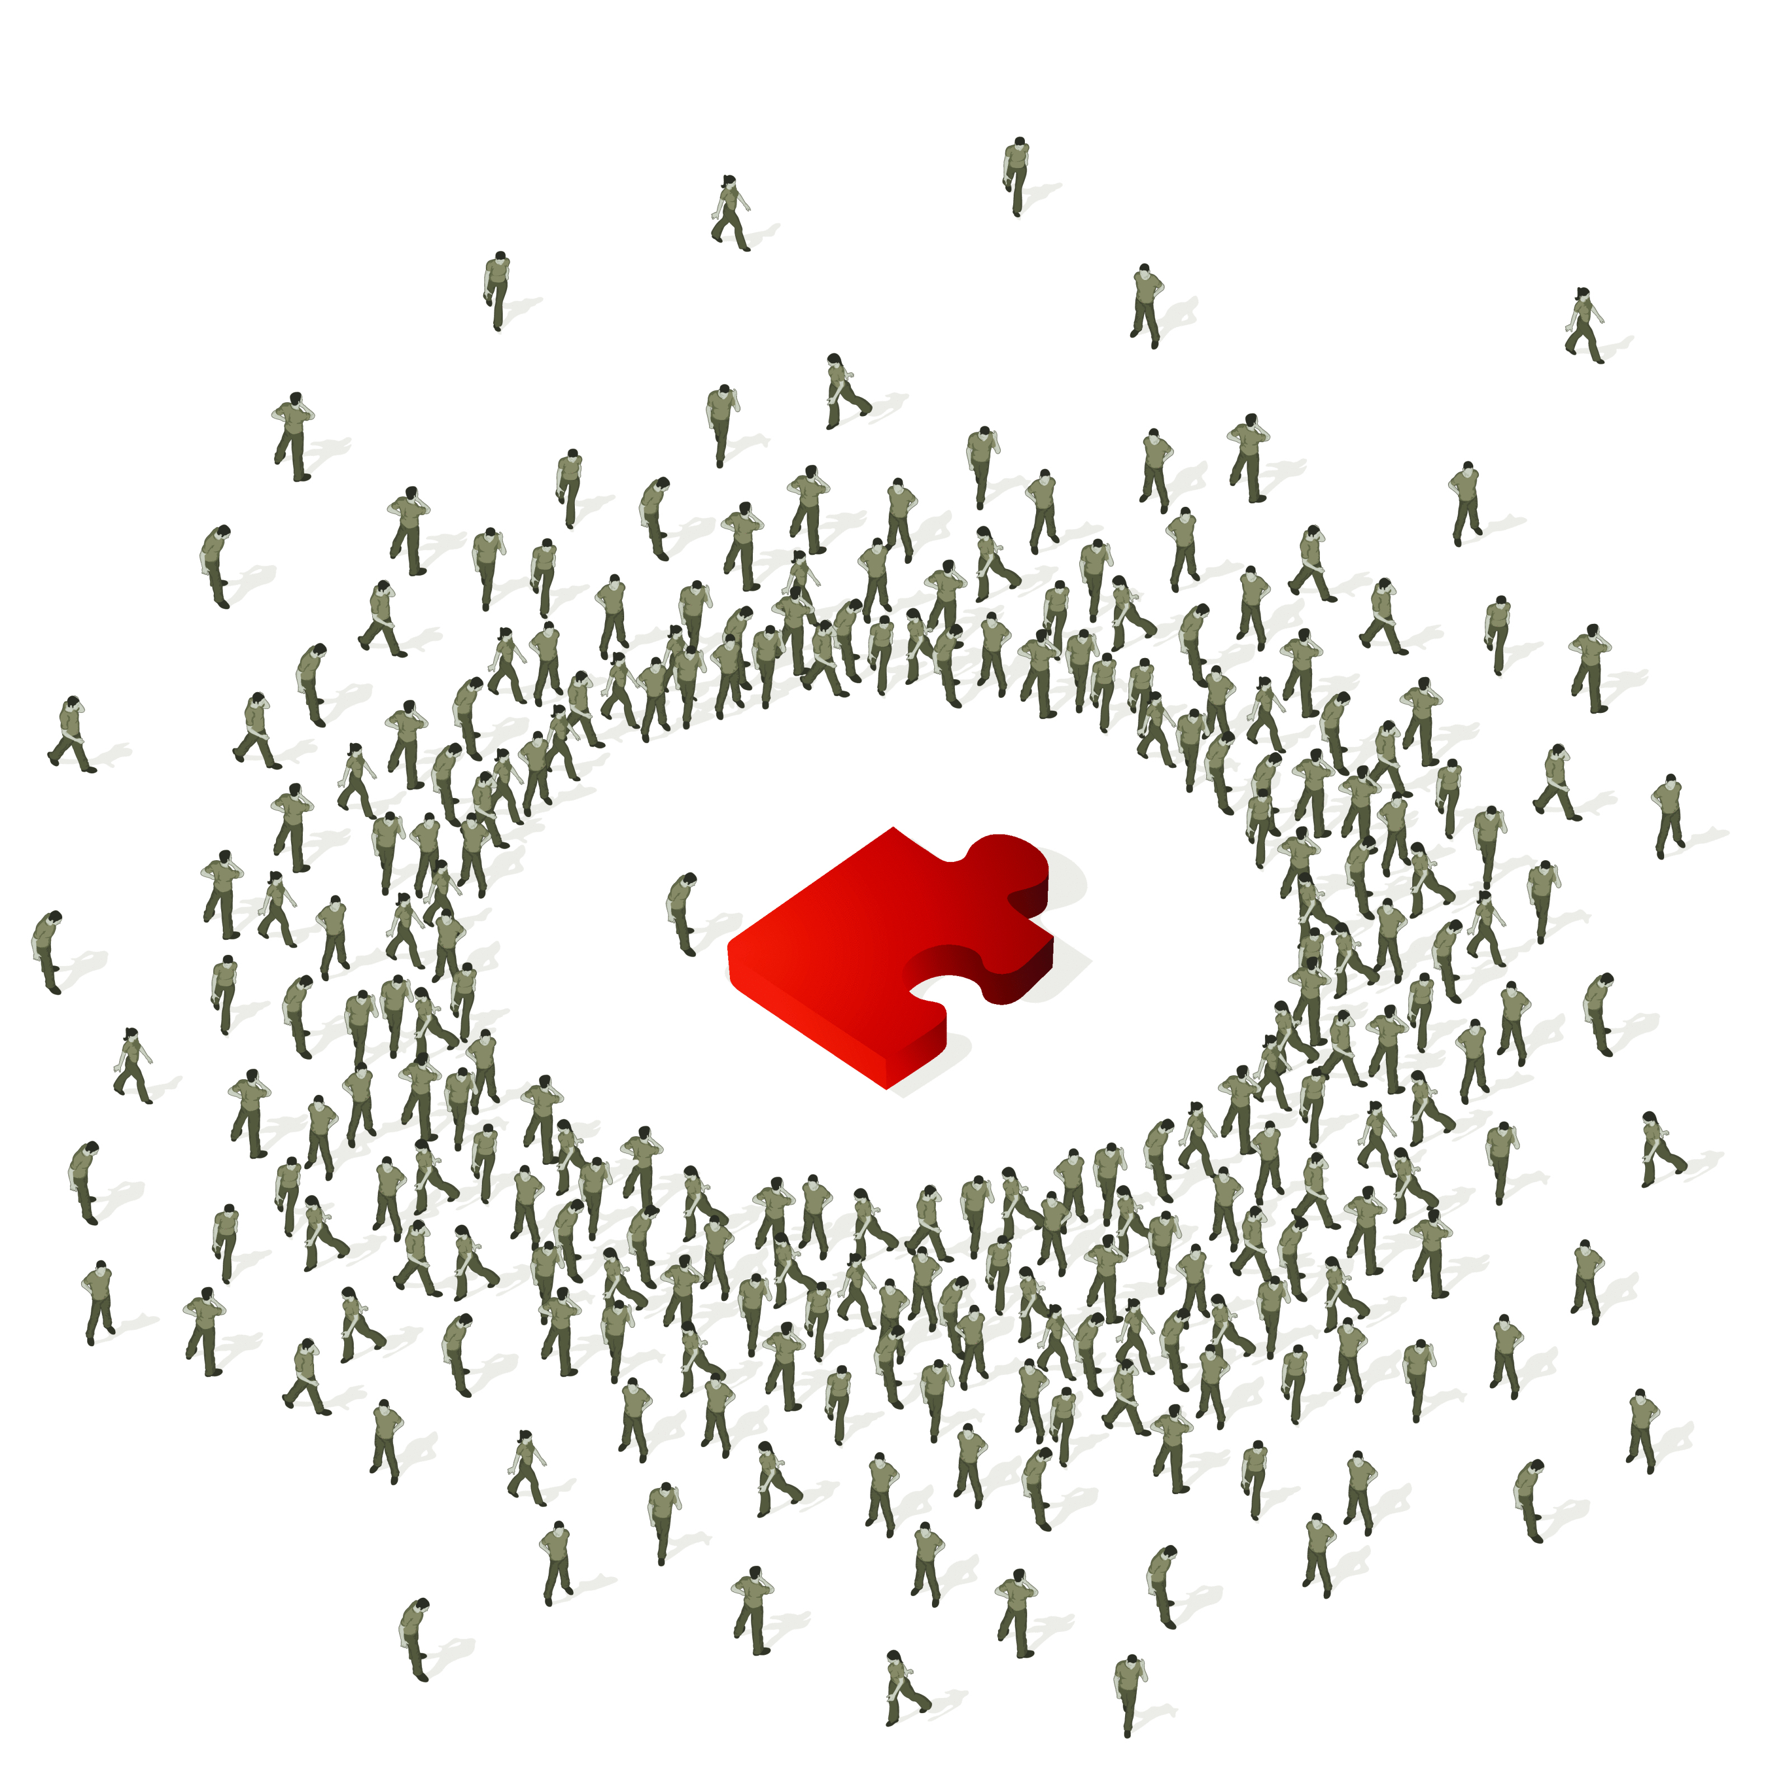
Future Work
Active integration by crowdsourcing

Slide 114
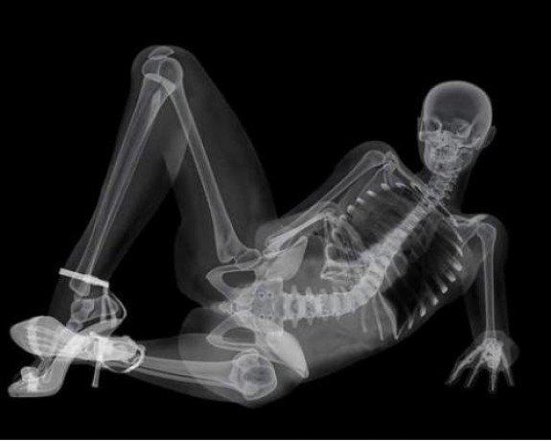
Future Work
Quality diagnosis

Slide 115
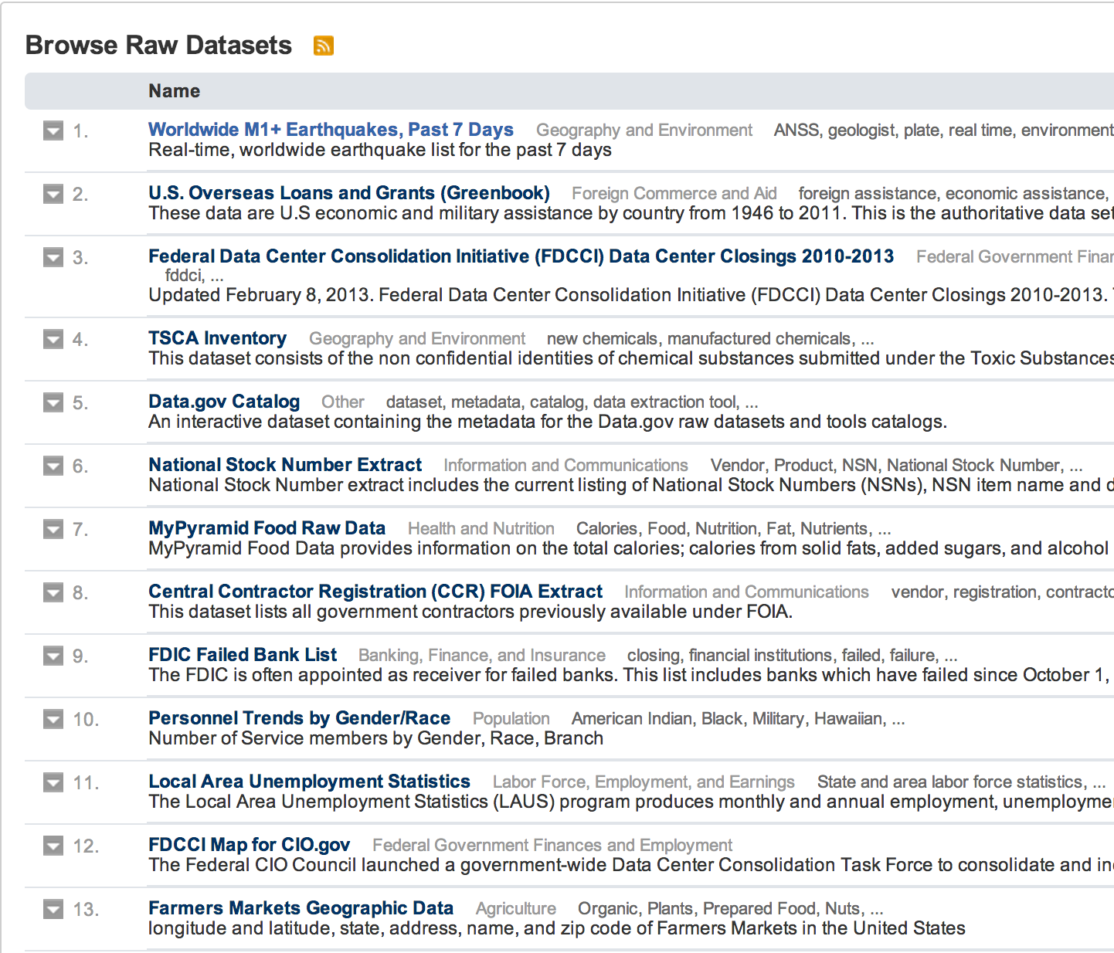
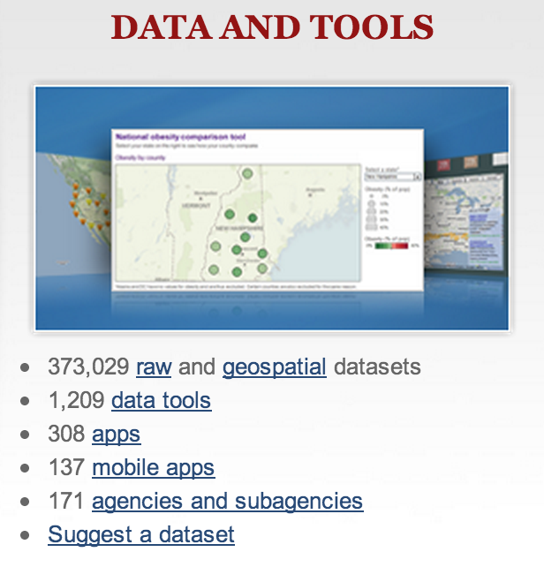
Future Work
Source exploration tool
Data.gov

Slide 116
Conclusions
Big data integration is an important area of research
Knowledge bases, linked data, geo-spatial fusion, scientific data
Much interesting work has been done in this area
Schema alignment, record linkage, data fusion
Challenges due to volume, velocity, variety, veracity
A lot more research needs to be done!

Slide 117
Thank You!

Slide 118
References
[B01] Michael K. Bergman: The Deep Web: Surfacing Hidden Value (2001)
[BBR11] Zohra Bellahsene, Angela Bonifati, Erhard Rahm (Eds.): Schema Matching and Mapping. Springer 2011
[CHW+08] Michael J. Cafarella, Alon Y. Halevy, Daisy Zhe Wang, Eugene Wu, Yang Zhang: WebTables: exploring the power of tables on the web. PVLDB 1(1): 538-549 (2008)
[CHZ05] Kevin Chen-Chuan Chang, Bin He, Zhen Zhang: Toward Large Scale Integration: Building a MetaQuerier over Databases on the Web. CIDR 2005: 44-55

Slide 119
References
[DBS09a] Xin Luna Dong, Laure Berti-Equille, Divesh Srivastava: Integrating Conflicting Data: The Role of Source Dependence. PVLDB 2(1): 550-561 (2009)
[DBS09b] Xin Luna Dong, Laure Berti-Equille, Divesh Srivastava: Truth Discovery and Copying Detection in a Dynamic World. PVLDB 2(1): 562-573 (2009)
[DDH08] Anish Das Sarma, Xin Dong, Alon Y. Halevy: Bootstrapping pay-as-you-go data integration systems. SIGMOD Conference 2008: 861-874
[DDH09] Anish Das Sarma, Xin Luna Dong, Alon Y. Halevy: Data Modeling in Dataspace Support Platforms. Conceptual Modeling: Foundations and Applications 2009: 122-138
[DFG+12] Anish Das Sarma, Lujun Fang, Nitin Gupta, Alon Y. Halevy, Hongrae Lee, Fei Wu, Reynold Xin, Cong Yu: Finding related tables. SIGMOD Conference 2012: 817-828

Slide 120
References
[DHI12] AnHai Doan, Alon Y. Halevy, Zachary G. Ives: Principles of Data Integration. Morgan Kaufmann 2012
[DHY07] Xin Luna Dong, Alon Y. Halevy, Cong Yu: Data Integration with Uncertainty. VLDB 2007: 687-698
[DNS+12] Uwe Draisbach, Felix Naumann, Sascha Szott, Oliver Wonneberg: Adaptive Windows for Duplicate Detection. ICDE 2012: 1073-1083

Slide 121
References
[EIV07] Ahmed K. Elmagarmid, Panagiotis G. Ipeirotis, Vassilios S. Verykios: Duplicate Record Detection: A Survey. IEEE Trans. Knowl. Data Eng. 19(1): 1-16 (2007)
[EMH09] Hazem Elmeleegy, Jayant Madhavan, Alon Y. Halevy: Harvesting Relational Tables from Lists on the Web. PVLDB 2(1): 1078-1089 (2009)
[FHM05] Michael J. Franklin, Alon Y. Halevy, David Maier: From databases to dataspaces: a new abstraction for information management. SIGMOD Record 34(4): 27-33 (2005)

Slide 122
References
[GAM+10] Alban Galland, Serge Abiteboul, Amélie Marian, Pierre Senellart: Corroborating information from disagreeing views. WSDM 2010: 131-140
[GDS+10] Songtao Guo, Xin Dong, Divesh Srivastava, Remi Zajac: Record Linkage with Uniqueness Constraints and Erroneous Values. PVLDB 3(1): 417-428 (2010)
[GM12] Lise Getoor, Ashwin Machanavajjhala: Entity Resolution: Theory, Practice & Open Challenges. PVLDB 5(12): 2018-2019 (2012)
[GS09] Rahul Gupta, Sunita Sarawagi: Answering Table Augmentation Queries from Unstructured Lists on the Web. PVLDB 2(1): 289-300 (2009)
[HFM06] Alon Y. Halevy, Michael J. Franklin, David Maier: Principles of dataspace systems. PODS 2006: 1-9

Slide 123
References
[JFH08] Shawn R. Jeffery, Michael J. Franklin, Alon Y. Halevy: Pay-as-you-go user feedback for dataspace systems. SIGMOD Conference 2008: 847-860
[KGA+11] Anitha Kannan, Inmar E. Givoni, Rakesh Agrawal, Ariel Fuxman: Matching unstructured product offers to structured product specifications. KDD 2011: 404-412
[KTR12] Lars Kolb, Andreas Thor, Erhard Rahm: Load Balancing for MapReduce-based Entity Resolution. ICDE 2012: 618-629
[KTT+12] Hanna Köpcke, Andreas Thor, Stefan Thomas, Erhard Rahm: Tailoring entity resolution for matching product offers. EDBT 2012: 545-550

Slide 124
References
[LDL+13] Xian Li, Xin Luna Dong, Kenneth B. Lyons, Weiyi Meng, Divesh Srivastava: Truth Finding on the deep web: Is the problem solved? PVLDB, 6(2) (2013)
[LDM+11] Pei Li, Xin Luna Dong, Andrea Maurino, Divesh Srivastava: Linking Temporal Records. PVLDB 4(11): 956-967 (2011)
[LDO+11] Xuan Liu, Xin Luna Dong, Beng Chin Ooi, Divesh Srivastava: Online Data Fusion. PVLDB 4(11): 932-943 (2011)

Slide 125
References
[MKB12] Bill McNeill, Hakan Kardes, Andrew Borthwick : Dynamic Record Blocking: Efficient Linking of Massive Databases in MapReduce. QDB 2012
[MKK+08] Jayant Madhavan, David Ko, Lucja Kot, Vignesh Ganapathy, Alex Rasmussen, Alon Y. Halevy: Google's Deep Web crawl. PVLDB 1(2): 1241-1252 (2008)
[MSS10] Claire Mathieu, Ocan Sankur, Warren Schudy: Online Correlation Clustering. STACS 2010: 573-584

Slide 126
References
[PIP+12] George Papadakis, Ekaterini Ioannou, Themis Palpanas, Claudia Niederee, Wolfgang Neidjl: A blocking framework for entity resolution in highly heterogeneous information spaces. TKDE (2012)
[PR11] Jeff Pasternack, Dan Roth: Making Better Informed Trust Decisions with Generalized Fact-Finding. IJCAI 2011: 2324-2329
[PRM+12] Aditya Pal, Vibhor Rastogi, Ashwin Machanavajjhala, Philip Bohannon: Information integration over time in unreliable and uncertain environments. WWW 2012: 789-798
[PS12] Rakesh Pimplikar, Sunita Sarawagi: Answering Table Queries on the Web using Column Keywords. PVLDB 5(10): 908-919 (2012)

Slide 127
References
[TIP10] Partha Pratim Talukdar, Zachary G. Ives, Fernando Pereira: Automatically incorporating new sources in keyword search-based data integration. SIGMOD Conference 2010: 387-398
[TJM+08] Partha Pratim Talukdar, Marie Jacob, Muhammad Salman Mehmood, Koby Crammer, Zachary G. Ives, Fernando Pereira, Sudipto Guha: Learning to create data-integrating queries. PVLDB 1(1): 785-796 (2008)
[VCL10] Rares Vernica, Michael J. Carey, Chen Li: Efficient parallel set-similarity joins using MapReduce. SIGMOD Conference 2010: 495-506
[VN12] Tobias Vogel, Felix Naumann: Automatic Blocking Key Selection for Duplicate Detection based on Unigram Combinations. QDB 2012

Slide 128
References
[WYD+04] Wensheng Wu, Clement T. Yu, AnHai Doan, Weiyi Meng: An Interactive Clustering-based Approach to Integrating Source Query interfaces on the Deep Web. SIGMOD Conference 2004: 95-106
[YJY08] Xiaoxin Yin, Jiawei Han, Philip S. Yu: Truth Discovery with Multiple Conflicting Information Providers on the Web. IEEE Trans. Knowl. Data Eng. 20(6): 796-808 (2008)
[ZH12] Bo Zhao, Jiawei Han: A probabilistic model for estimating real-valued truth from conflicting sources. QDB 2012
[ZRG+12] Bo Zhao, Benjamin I. P. Rubinstein, Jim Gemmell, Jiawei Han: A Bayesian Approach to Discovering Truth from Conflicting Sources for Data Integration. PVLDB 5(6): 550-561 (2012)

